Slide 1
Equity Research Initiative Program
KAPIL AGRAWAL
2014B3A3579P
BITS PILANI, PILANI CAMPUS

Slide 2
Introduction
Tata Motors Limited is an Indian multinational automotive manufacturing company.Its products includes passenger cars, trucks, vans, coaches, buses and military vehicles.It is headquartered in Mumbai. It has manufacturing plants in Jamshedpur, Pantnagar, Lucknow, Sanand, Dharwad and Pune districts of India and in countries like Argentina, South Africa, Thailand and United Kingdom. At present, Tata Motors is the world’s 17th-largest motor vehicle manufacturing company, fourth-largest truck manufacturer and second-largest bus manufacturer company.It is a part of Tata group and was established in 1945.It entered the segment n 1954.Over 9 million Tata Vehicles run on Indian roads, since first rolled out in 1954. It started exporting its products in the year 1961 and thus established the international footprint in the world.

Slide 3

Overview of TML
Company Name: Tata Motors Ltd
Area served: Worldwide
Year of Incorporation: 1945
Number of employees: 73,485
Industry: Automotive
Chairman Emeritus: Ratan Tata
Chairman: Cyrus Pallonji Mistry

Slide 4
Pest Analysis
Pest analysis means Political, Economical, Social and Technolgical way of analyzing any company.
It is a standard way of analyzing macro-economical forces which impact a company or corporation.
Pest analysis helps to infer whether a particular factor is helping the organization to achieve its goals.
Hence, its very important to perform Pest analysis on any company to study its behaviour.

Slide 5
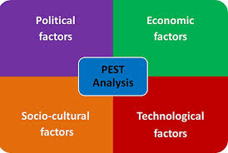
Illustration of Pest Analysis

Slide 6
Political factors
Tata Motors Limited have a good political relation with the both previous and present governments of India.
For the manufacturing of Nano Cars, Tata Motors Limited accquired a land of 997 acres with the Gujarat state government, with this decision farmers were displaced and thus they were unhappy. Taking advantage it, other opposition parties like TMC of Mamata Bannerjee started a “Save Farmland” movement. Anyway, finally plant was estabblished in Sanand, Gujarat.
Conclusion : Tata Motors Limited mantains a good relation with major powerful political parties which helps them in taking important actions.

Slide 7
Economical factors
TML’s economic scenario is quite promising with GDP growth rate around 7%.
However, high interest rates and low freight availability impacted its financial infrastructure in first quarter of 2013.
During the same time, price pressure from competitors also married its financial position.
The commercial vehicle segment of TML gave it an edge over others this time and the big and mid-sized vehicles helped TML to regain its ground.

Slide 8
Social factors
Where ever TML goes, may it be domestic or international markets, it hires mostly the local population generating employment.
Due to its age long history and its welfare activities, Tata enjoys full public support.
Tata also works towards provided high standards of education to students.Some of the institutes opened and managed by Tata are Indian Institute of Science, Tata Memorial Centre, Tata Institute of Social Sciences, etc.
Besides automotive industries, there are many beneficial Tata products available in Indian market which are the daily basic needs of the people.

Slide 9
Technological factors
In order to adapt with the latest technology, TML owns Tata Technologies Limited.
Tata Technologies Limited helps TML in the upgradation of designs and technology.
Tata faced some technological challenges when Tata Nano was introduced in the markets but it later assured the customers that Nano is perfectly safe to drive.

Slide 10
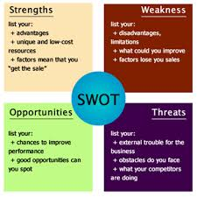
Swot Analysis
Swot analysis means study of strengths, weaknesses, opportunities and threats of any company. Also, by performing swot analysis we get to know about the factors which are favourable for the company’s main objectives.

Slide 11
Strengths of Company
1.Tata is the leading manufacturer of automobiles in India and it has hence strong hold in Indian domestic market.
2.It produces many types of products which generally satisfies the needs of all types of people.
3.Also, Tata motors is present globally in many countries of the world.
4.Tata Motors is fourth biggest truck producer in the world.
5.Tata Motors is the second biggest bus producer in the world.

Slide 12
Weaknesses of Company
1.Tata motors products are not considered as luxorious because products are generally targeted for economy claass rather than luxury.
2.Also investors are not satisfied with the return on investment on Tata motors because earnings per shares is low.
3.Also there is very less value of the Brand Recognition of the company.

Slide 13
Opportunities of Company
1.Tata Motors industry needs to work on production of some luxurious cars and vehicles, as presently it does not have any luxorious vehicle.
2.Also it has to make their investors happy by raising the value of Earnings per share.

Slide 14
Threats for company
1.Other competing car manufacturers have been in the passenger car business for 40 to 50 years.Therefore, Tata Motors Limited has to catch up in terms of quality and lean production.
2.Low safety standards can hamper the public trusts it has already attained which may prove fatal to its domestic market.
3.Rising cost of manufacturing: The price of steel and aluminium is increasing and thus putting pressure on the costs of production.
4.Many of Tata’s products run on Diesel fuel which is becoming expensive globally and within the domestic market too.

Slide 15
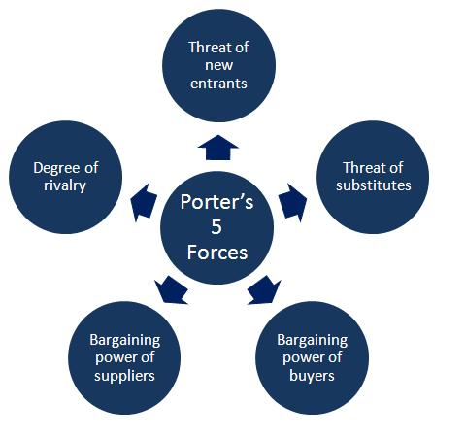
Porter’s five forces model
The Porter’s Five Forces tool is helpful to assess the attractiveness of an industry or a market by analyzing the forces acting upon it.

Slide 16

Intensity of Existing Rivalry
Large industry size
Fast industry growth rate

Slide 17
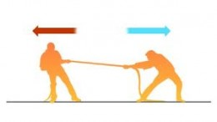
Bargaining power of suppliers
High competition among suppliers
Diverse distribution channel
Low cost of switching suppliers
Volume is critical to suppliers

Slide 18

Bargaining power of customers
Driving prices far below competitors, causing them to exit, thus shifting power with buyers back to the firm.
Low buyer price sensitivity.
Large number of customers.

Slide 19
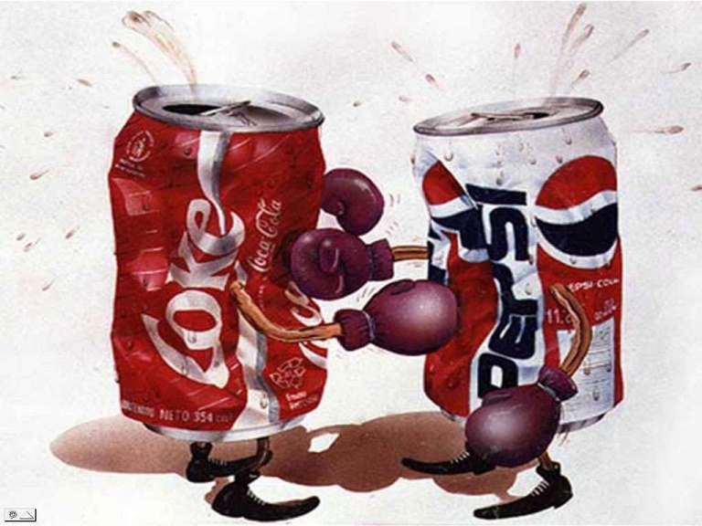
Threat of substitutes
Price band.
Substitutes performance.

Slide 20

Threat of new entrant
High capital requirements
Strong distribution network required.
Advanced technologies are required.
Industry requires economies of scale.
Entry barriers are high.

Slide 21
Ratio Analysis
Ratio Analysis is quantitative analysis of information obtained in a company’s financial statements.
It is used to evaluate various aspects of a company’s operating and financial performance such as its efficiency, liquidity, profitability and solvency.
Values of ratios are compared with different companies ratios in the same sector to see how they stack up, and to get an idea of comparative valuations.
It is a cornerstone of fundamental analysis.

Slide 22
Operating Margin
Operating Margin : EBIT / Net Sales
These values tells us that company made highest profit from it’s current operations in the year 2011 followed by 2012 which is followed by 2013 and further followed by 2014.In year 2015, company made losses from it’c current actions.
YEAR | 2011 | 2012 | 2013 | 2014 | 2015
TATA MOTORS | 0.076 | 0.047 | 0.035 | 0.009 | -0.065

Slide 23
comparison with different competitors
These values tells us that MAHINDRA is making most profit from it’s current performing actions than any other companies, followed by GM which is followed by FORD.
TATA motors is making losses from it’s current performing actions.
Company | Year | Operating margin value
FORD | 2015 | 2.97 %
GM | 2015 | 3 %
MAHINDRA | 2015 | 7.74 %
TATA MOTORS | 2015 | -6.5 %

Slide 24
EBT margin
Formula: EBT / Net Sales
It includes the total profit the company makes before paying tax.
These values tells us that company company is highly likely to make most profit out of its sales in the year 2011 because of high EBT margin value followed by year 2012 which is followed by year 2013.
In year 2014, 2015 company suffered from losses as it has made negative earnings which means losses.
Year | 2011 | 2012 | 2013 | 2014 | 2015
TATA MOTORS | 0.047 | 0.025 | 0.004 | -0.03 | -0.11

Slide 25
comparison of EBT margin with different companies
MAHINDRA is highly likely to make the most profit than FORD, GM and TATA MOTORS in the year 2015. Hence by looking this values, investors best choice will be MAHINDRA followed by GM which is followed by FORD. Investors will try to avoid investing money in TATA MOTORS.
Company | Year | EBT margin value
FORD | 2015 | 3.69 %
GM | 2015 | 4.79 %
MAHINDRA | 2015 | 7.86 %
TATA MOTORS | 2015 | -11 %

Slide 26
Return on Assets
It tells how much profit a company is able to generate for each unit of assets invested.
It measures the operating efficiency of a company.
The company was able to make the most profit in the year 2011 and least in year 2013, while in 2015 company was not even able to make profit and suffered from losses.
YEAR | 2011 | 2012 | 2013 | 2014 | 2015
TATA MOTORS | 0.05232 | 0.040 | 0.009 | 0.01 | -0.1357

Slide 27
comparison of ROA value with different companies
These values shows that MAHINDRA managed to make the most profit out of it’s assets while GM the least and Tata Motors was not even able to make profit and suffered a huge losses.
Company | Year | ROA value
FORD | 2015 | 1.73 %
GM | 2015 | 2.49 %
MAHINDRA | 2015 | 5.67 %
TATA MOTORS | 2015 | -13.57 %

Slide 28
Return on Equity value (ROE)
Formula: Net Profit / Shareholder Equity
Very low positive values in the year 2011-2014 indicates that company is making profits but it is very less and in 2015, the value is negative which means company is suffering from losses.
YEAR | 2011 | 2012 | 2013 | 2014 | 2015
TATA MOTORS | 0.091 | 0.063 | 0.016 | 0.018 | -0.32

Slide 29
return on equity value of different companies
A higher R/E value is better than lower. So, for Mahindra R/E value is the best and hence shareholders of Mahindra will make more profits and will get the maximum return followed by FORD and GM whereas negative R/E value means shareholders of TATA MOTORS are incurring losses and hence there is no return at all rather they have to pay their own money for the suffered losses.
Company | Year | ROE value
FORD | 2015 | 13.92 %
GM | 2015 | 12.29 %
MAHINDRA | 2015 | 21.57 %
TATA MOTORS | 2015 | -32 %

Slide 30
Current ratio
It is measure of the ability of a firm to meet its short-term obligations.
A current ratio of 2 to 3 is usually considered good.
A very high value ( >3) indicates that the firm has too many assets tied up and is not making efficient use of them and also company having high current ratio value becomes attractive to creditors who are expecting to be paid in next few period of time.
YEAR | 2011 | 2012 | 2013 | 2014 | 2015
TATA MOTORS | -0.32 | -0.44 | -0.41 | -0.48 | -0.32

Slide 31
Current ratio of different companies
The best value of current ratio is of FORD (close to 3) and the values of GM and MAHINDRA are not so bad but they have less potential to overcome their obligations. On the other way, TATA MOTORS having the current ratio value less than 1 which indicates company is in bad financial health.
Company | Year | Current ratio value
FORD | 2015 | 3.03
GM | 2015 | 1.22
MAHINDRA | 2015 | 1.44
TATA MOTORS | 2015 | -0.32

Slide 32
P/E ratio
Lesser the P/E ratio value, it becomes more attractive for the investors to invest money in that company.
Industries like technology has a very high P/E ratio around 17 whereas public utilities industry have a very low P/E ratio value around 3.
As the P/E value was very high in 2013-2014, TML was unfavourable for many investors as they had to deposit large amount of money to earn unit profit.
YEAR | 2011 | 2012 | 2013 | 2014 | 2015
TATA MOTORS | 11.57 | 84.46 | 347.63 | 317.55 | -22.44

Slide 33
Meaning of negative P/E ratio
P/E ratio can also be negative if the value of Earnings per share (EPS) is negative.
EPS values below 0 means that the company is losing money.
Investors buying a company with a negative P/E should be aware that they are buying a share of a company that has been losing money per share of its stock.
It is very unfavourable value for the investors and investors will avoid to invest money in the company having negative P/E ratio.

Slide 34
comparison of P/E ratio with different companies
As Tata Motors is having negative P/E value, investors will avoid them.
The best choice for investors will be GM followed by FORD which is followed by MAHINDRA.
Company | Year | P/E value
FORD | 2015 | 14.88
GM | 2015 | 11.12
MAHINDRA | 2015 | 22.01
TATA MOTORS | 2015 | -22.44

Slide 35
Assets turnover value
Value of Assets turnover indicates the efficiency with which a company is utilizing its assets in generating revenue.
Since value is close to 1 in 2014 and 2015, which is not good for company. If value of assets turnover is close to 1, then it means there is very less chance of making profits.
Higher the assets turnover ratio value, better the company is performing since higher ratios that the company is generating more revenue per unit of assets.
YEAR | 2011 | 2012 | 2013 | 2014 | 2015
TATA MOTORS | 1.36 | 1.77 | 1.34 | 1.02 | 1.04

Slide 36
comparison with competitors
As the value for Tata Motors is highest, it means Tata motors is utilizing its resources in a best way than any other company.
As the value for Ford is lowest, it means Ford’s efficiency of utilizing its assets (resources) is very less and thus not able to generate more revenue per unit of assets.
Company | Year | Assets turnover value
FORD | 2015 | 0.66
GM | 2015 | 0.84
MAHINDRA | 2015 | 0.9
TATA MOTORS | 2015 | 1.04

Slide 37
P/S ratio value
It is considered more stable than P/E ratio.
P/S ratio value was highest in the year 2014 followed by the year 2015 which is followed by the year 2013 and is further followed by the year 2012.
It helps determine a stock’s relative valuation.
P/S ratio = Price per share / Annual Net Sales per share
YEAR | 2011 | 2012 | 2013 | 2014 | 2015
TATA MOTORS | 0.445 | 1.93 | 2.35 | 3.1 | 2.9287

Slide 38
P/S ratio values of different companies
The lower the ratio, the more attractive the investment.
Hence from investors point of view, MAHINDRA is the best company to invest followed by GM which is further followed by FORD and TATA MOTORS is the company which investors will try to avoid.
Company | Year | P/S value
FORD | 2015 | 0.3872
GM | 2015 | 0.3297
MAHINDRA | 2015 | 0.176
TATA MOTORS | 2015 | 2.9287

